Slide 1



Part3
27 August 2019

Slide 2
AGENDA
Lifecycle hooks
Dynamic components
Change detection
Forms
Lazy Loading
Route guards

Slide 3
Lifecycle Hooks
From documentation:
Directive and component instances have a lifecycle as Angular creates, updates, and destroys them. Developers can tap into key moments in that lifecycle by implementing one or more of the lifecycle hook interfaces in the Angular core library.
After creating a component/directive by calling its constructor, Angular calls the lifecycle hook methods in the following sequence at specific moments
And add a method, with ‘ng’ prefix in it’s name:
ngDoCheck(){
// Called during every change detection run, immediately after ngOnChanges() and ngOnInit().
}
ngAfterConentInit() {
// Called once after the first ngDoCheck().
}
ngAfterConentChecked(){
// Called after the ngAfterContentInit() and every subsequent ngDoCheck().
}
ngAfterViewChecked(){
// Called once after the first ngAfterContentChecked().
}
ngAfterViewInit(){
// Called after the ngAfterViewInit() and every subsequent ngAfterContentChecked().
}

Slide 4
Dynamic Components
Dynamic means, that the components location in the application is not defined at buildtime. That means, that it is not used in any angular template.
Instead, the component is instantiated and placed in the application at runtime.
Because of the way angular works, it has to know about every component at buildtime.
That means that the component has to be defined in the same project or has to be imported into an angular module of the project.
appendDialogComponentToBody(){
const componentFactory = this.componentFactoryResolver.resolveComponentFactory(DialogComponent);
}

Slide 5
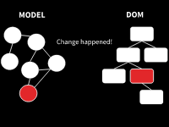

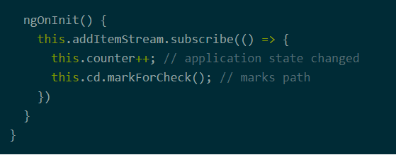
Change Detection
The basic task of change detection is to take the internal state of a program and make it somehow visible to the user interface. This state can be any kind of objects, arrays, primitives, … just any kind of JavaScript data structures.
Basically application state change can be caused by three things:
Events - click, submit, …
XHR - Fetching data from a remote server
Timers - setTimeout(), setInterval()
Angular comes with its own zone called NgZone, which we’ve written about in our article Zones in Angular
Change detection strategy(OnPush)

Slide 6
Angular forms
FormControl tracks the value and validation status of an individual form control.
FormGroup tracks the same values and status for a collection of form controls.
FormArray tracks the same values and status for an array of form controls.
ControlValueAccessor creates a bridge between Angular FormControl instances and native DOM elements.
Forms use a form model to track value changes between Angular forms and form input elements.
Reactive forms define custom validators as functions that receive a control to validate.
Template-driven forms are tied to template directives, and must provide custom validator directives that wrap validation functions.
Dynamic forms
Mutability
Scalability

Slide 7

Angular forms - Template - driven
Template-driven forms are useful for adding a simple form to an app, such as an email list signup form. They're easy to add to an app, but they don't scale as well as reactive forms. If you have very basic form requirements and logic that can be managed solely in the template, use template-driven forms.
<label for="name">Name</label>
<input type="text" class="form-control" id="name" required [(ngModel)]="model.name" name="name"
#name="ngModel">
<div [hidden]="name.valid || name.pristine“ class="alert alert-danger">
Name is required
</div>

Slide 8
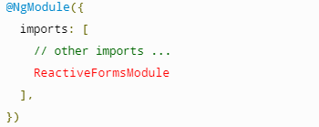
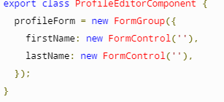
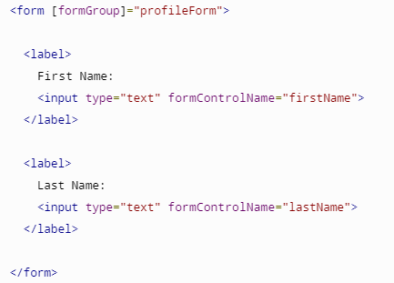
Angular forms - Reactive
Reactive forms are more robust: they're more scalable, reusable, and testable. If forms are a key part of your application, or you're already using reactive patterns for building your application, use reactive forms.

Slide 9
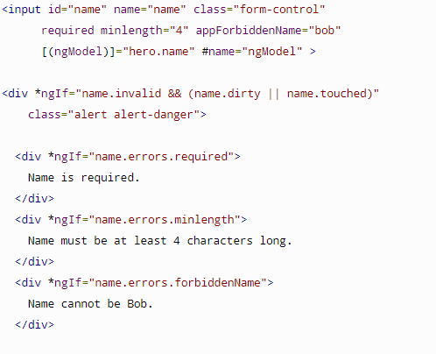
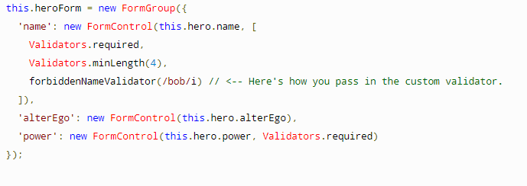
Form Validations

Slide 10
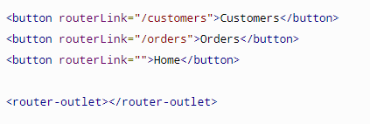
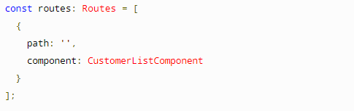
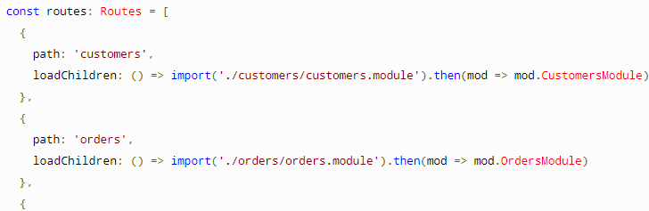
Lazy loading
By default, NgModules are eagerly loaded, which means that as soon as the app loads, so do all the NgModules, whether or not they are immediately necessary. For large apps with lots of routes, consider lazy loading—a design pattern that loads NgModules as needed. Lazy loading helps keep initial bundle sizes smaller, which in turn helps decrease load times.
There are three main steps to setting up a lazy loaded feature module:
Create the feature module.
Create the feature module’s routing module.
Configure the routes.

Slide 11
Route guards
Any user can navigate anywhere in the application anytime. That's not always the right thing to do.
Perhaps the user is not authorized to navigate to the target component.
Maybe the user must login (authenticate) first.
Maybe you should fetch some data before you display the target component.
You might want to save pending changes before leaving a component.
You might ask the user if it's OK to discard pending changes rather than save them.
A guard's return value controls the router's behavior:
If it returns true, the navigation process continues.
If it returns false, the navigation process stops and the user stays put.
If it returns a UrlTree, the current navigation cancels and a new navigation is initiated to the UrlTree returned.
The router supports multiple guard interfaces:
CanActivate to mediate navigation to a route.
CanActivateChild to mediate navigation to a child route.
CanDeactivate to mediate navigation away from the current route.
Resolve to perform route data retrieval before route activation.
CanLoad to mediate navigation to a feature module loaded asynchronously.

Slide 12
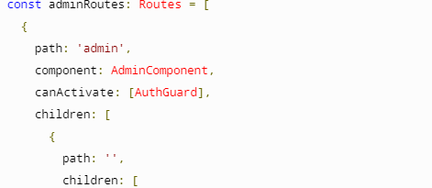
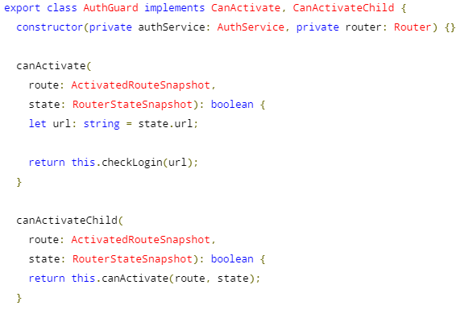
Route gurads

Slide 13
Thank you!

